Slide 1
Improved Feedback Mechanisms of Hydraulics Sandbox Simulator
Dr. Karen Johnson and Martin Hebel
Aviation Technologies – Southern Illinois University

Slide 2
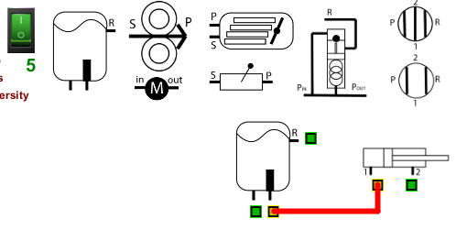
Hydraulics Sandbox
Developed by the presenters
Allows simulating the build of a hydraulics system with standard components
The software checks for valid and invalid connections
Hopefully will be beneficial in students’ understanding

Slide 3
Quick Use Guide
Download from: www.selmaware.com/sandbox PC & Linux installers, other options for MacOS
Drag components to build area
Click a port to connect hose - Right-click to cancel a hose
Right-Click a port to delete a hose
A Component must be disconnected to drag
Drag components to trash to delete
Turn on switch to check connection validity - Counter will update each time turned on

Slide 5
Implementation
Hydraulic Systems and Landing Gear Course (16 weeks)
Section 1 (n=17) - concurrent sandbox
Section 2 (n=17) - terminal sandbox
Both sections given the same list of components each week to create their system
Submitted screenshots of final build with timestamps and attempts
Unit tests (4 plus final exam)
Drawing (on paper) a schematic with given list of components
MCQs related to component interactions within a system
General and system specific

Slide 6
Findings
No statistically significant results
Only (very) minor differences in actual numbers of right/wrong on assessments
Terminal group did slightly better on both schematics and MCQ
Overall more attempts made (weekly) by the concurrent group
Started over rather than using the trash bin?
Overall more time logged (weekly) by the concurrent group
More time going back to fix errors along the way?
Chalk this up to a pilot study of the software

Slide 7
Theory Of Code Operation

Slide 8
Hydraulics Sandbox Code
Installers available for Windows and Linux. www.selmaware.com/sandbox The installers add an updated that can be used to check if a new version is available.
A zip of the code is available under MacOS distribution – can be used on all platforms:
Developed using the Processing 3 Java environment, which is free.
Directions on the page explain how to make your own .exe build – open and export, done. Modify if you desire! Please do not publicly distribute.
This is required for local MacOS distribution on flash drives as the exe did not pass Apple’s Notarization checks for download use.

Slide 9
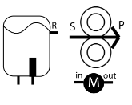
Component Objects
There is a single component object.
All the various components are created at load with a finite number of each.
At creation of each, they are indexed in a certain range, such as the variable displacement pumps are 10 – 14. The also are assigned an image and component type, along with size information.
for(i=10; i<15;i++) // create 5 variable pumps, #3
component[i] = new Components(350,30,100,i,3, "Variable Displacement Pump.png");

Slide 10
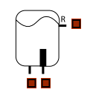
Port Objects
Each component can have up to 4 connection ports.
When placed in the build area, ports are added based on the Component ID.
Each port number is indexed based on the index of the component:
component index x 4 + 0 component index x 4 + 1 component index x 4 + 2 component index x 4 + 3
For the variable displacement pump (index 10), the ports will be 40, 41, 42 and 43 (if all 4 had been used).
This allows quick identification of components from the port index number.

Slide 11
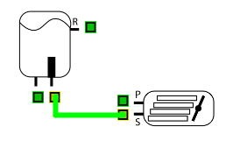
Hose Objects
When a hose is placed, the beginning and end port index numbers are assigned to it.
This allows easy identification of the component indexes the hose is connected to (40/4 = component index 10) and which ports by resolving 40, 41, 42, 43 to 0, 1, 2, 3.
Having the component index, that component object can be polled to determine its type.

Slide 12
Connection Verification Rules
Being able to resolve the port number and the component type, the rules check for 4 rule sets by checking each hose in sequence:
Is there a valid connection?
Does it connect to itself some how?
Is there an invalid connection via tees?
Is there a valve/actuator agreement?
for (int i=0;(i < numHoses); i++) // go through each hose used
{
connCount = 0;
if (hose[i].visible()) { // if visible
finalResult = checkHoses(i); // check for proper connections
if (finalResult) finalResult = test2Self(i); // go ensure it doesn't connect to itself
if (finalResult) finalResult = checkBadTeeConnections(i); // go run through not-allowed connection list
if (finalResult) finalResult = valves2Actuators(i); // check valve/actuator agreement for both hoses
setHose(i, finalResult);
}
}

Slide 13
Valid Connection Rules
A valid connection rule checks component type and port to another component type and port for each hose.
if (testHose(i,res,1,constDispPump,0)) return true;
if (testHose(i,res,1,varDispPump,1)) return true;
if (testHose(i,pressReg,2,closedCenterValve,0)) return true;
if (testHose(i,pressReg,2,closedCenterValve,1)) return true;

Slide 14
Invalid Connection Rules
While a hose may check ok, a tee from it may form an invalid connection.
Some invalid connections are checked to provide a feedback message to the user when they place the pointer over the connection.
The port is not checked in all cases, just the component types.
if (testCompHose(i,res,actuator)) {
hoseMsg[i][0]="This connection would not supply pressure to the actuator";
return false;
}

Slide 15
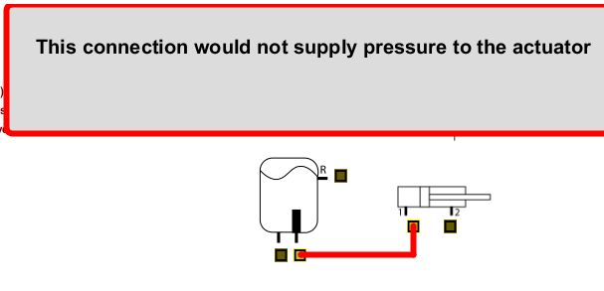
Example Feedback

Slide 16
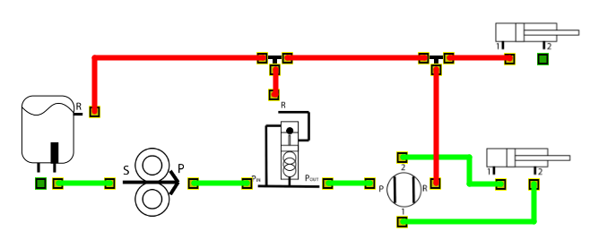
Tee Checks
While a single hose connection may be good, hoses from the tees, and subsequent tees and their hoses need to checked for validity.
This is done with recursive calls to trace a path through multiple tees.

Slide 17
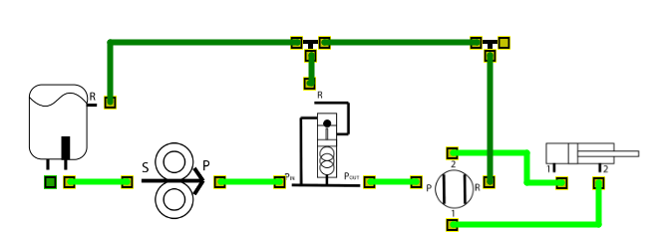
Return Lines
Hoses are checked to see if they connect to the reservoir return and displayed in dark green.
if (result){
if (testHose(i,res,3)) // in return line, make dark green
hose[i].finish(color(0,128,0));
else
hose[i].finish(color(0,255,0)); // good, normal green
}
else
hose[i].finish(color(253,0,0)); // bad, red

Slide 18
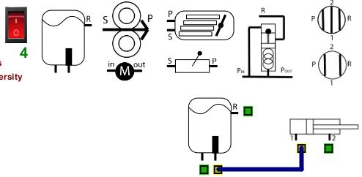
Enabling Checking
When the toggle switch is off, hoses are not checked and will remain blue.
When turned on, hoses are checked, and the counter is increased to allow verifying during a quiz situation. While on, any subsequent hoses placed will be checked.

Slide 19
Summary
Final use notes
There is NO saving/opening builds.
Do NOT press the escape key - It will close.
To start a new build, close and re-open or it may become sluggish and the parts bin may empty.
A Windows and Linux installer is available. Mac versions need to be ‘Exported’ using the source code for local manual distribution.
Bugs may still exist depending on what the student does but is effective at helping them understand a hydraulics system build we hope.

